Slide 1
Pizza Restaurant Analysis in US
Group Members:
Chau Ka Yan (1155158643)
Chen Lu (1155157122)
Fan Jingyi (1155157249)
LI SHENGWEI (1155143605)
LUI CHAK SUM (1155158054)
Wong Tuen Hung (1155158385)

Slide 2
Background Information
This year is 2016.
From the data set we collected, there are at least 1,749 pizza restaurants operating in the US.
You are interested in entering the competitive pizza restaurant market.
You hired us to provide professional analysis and give some advices on setting up the restaurant.

Slide 3
Problem Statement
What decisions should you make regarding important factors such as pizza pricing, menu options, restaurant location, branding, and other strategies to set your pizza restaurant up for success?

Slide 4
TABLE OF CONTENTS
01
02
03
04
Data Preparation
Data Visualization
Regression
Confidence Interval & Prediction Interval
05
Decision Tree
06
Conclusion

Slide 5
01
Data Preparation
Analysis start with high quality data

Slide 6
Data Checking
20 Variables in the data set (address, city , latitude, longitude etc.)
There are N/A or zero data in the numeric variables which are maximum price and the minimum price of pizzas.
N/A and zero data can cause the calculation mistakes when the formula is applied in the R or Python
Data Cleaning
Data Imputation

Slide 7
Data Cleaning(1)
If data cleaning is applied, 563 data will be dropped out based on N/A and zero data in the maximum price variable.
However, those data still contain much valuable information such as "pizza name" and "address".

Slide 8
Data Imputation
Keeping data is preferred instead of deleting data.
Use sample mean to replace the N/A data and zero data by python sklearn.impute simpleImputer function.
Finally, N/A and zero values of Maximum and Minimum data are replaced by mean(12.48) and mean(11.43) respectively.

Slide 9
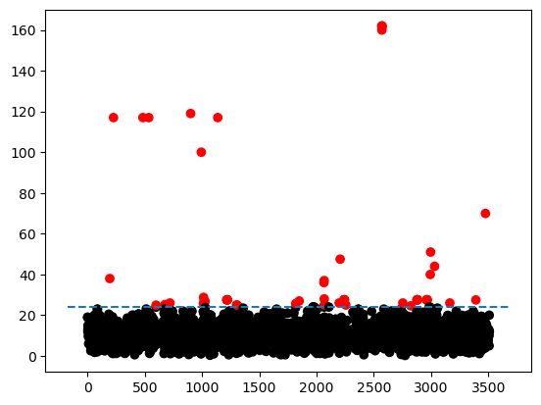
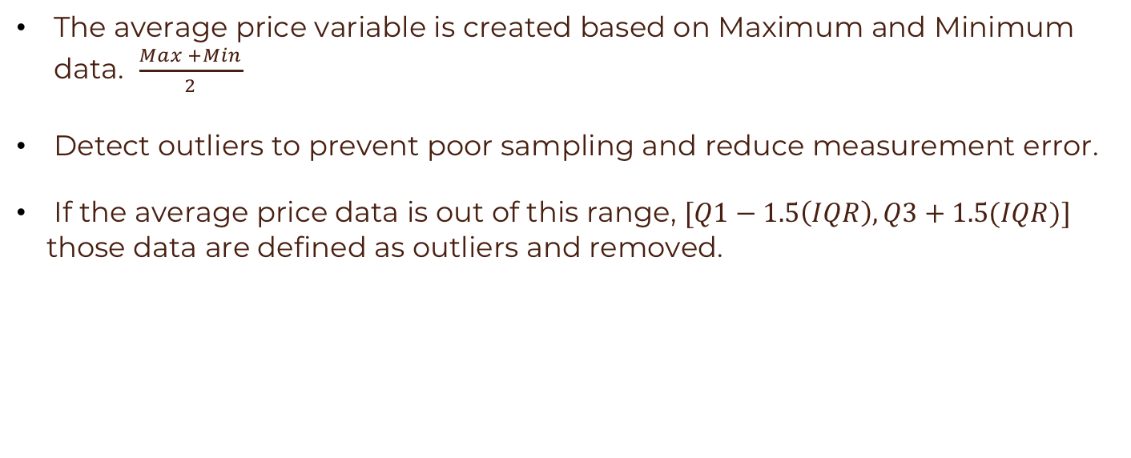
Data Cleaning(2)
The average price variable is created based on Maximum and Minimum data. $\frac{Max +Min}{2}$
Detect outliers to prevent poor sampling and reduce measurement error.
If the average price data is out of this range, $[Q1−1.5\left(IQR\right),Q3+1.5(IQR)]$
those data are defined as outliers and removed.
59 outliers are detected and deleted in our data set

Slide 10
02
Data Visualization
Enable understanding of complex data analytics

Slide 11
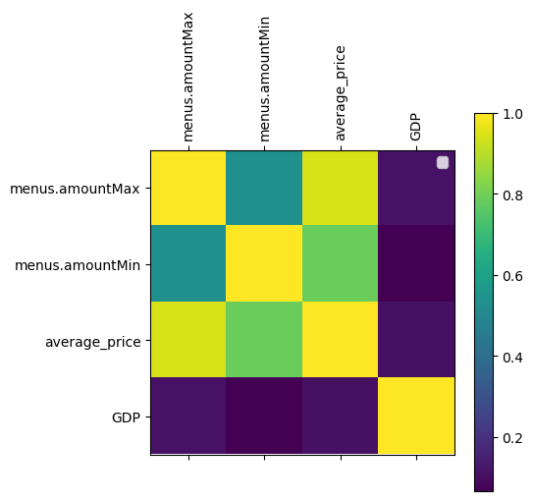
Correlation between Variables
Maximum price has the highest positive correlation with average price within other two variables.
Minimum price has the second highest positive correlation with average price
GDP is lower correlated with other three variables.

Slide 12

Data Visualization
1.Restaurant Brand
2.Pizza type
$
3.Average price
4.State and location

Slide 13
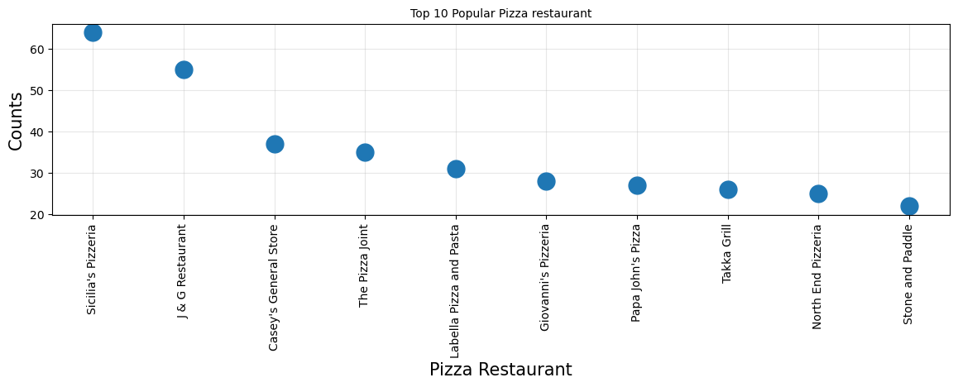
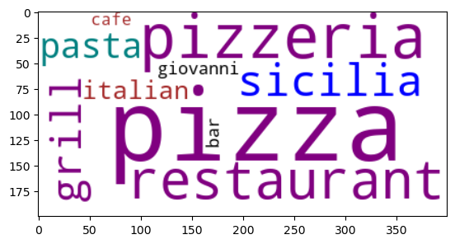
The Top 10 Pizza Restaurant brands in the US
Rank​ | Pizza Restaurant Name | Frequency​
1​ | Sicilia's Pizzeria | 64
2​ | J & G Restaurant | 55
3​ | Casey's General Store | 37
4​ | The Pizza Joint | 35
5​ | Labella Pizza and Pasta | 31
6​ | Giovanni's Pizzeria | 28
7​ | Papa John's Pizza | 27
8​ | Takka Grill | 26
9​ | North End Pizzeria | 25
10​ | Stone and paddle | 26

Slide 14
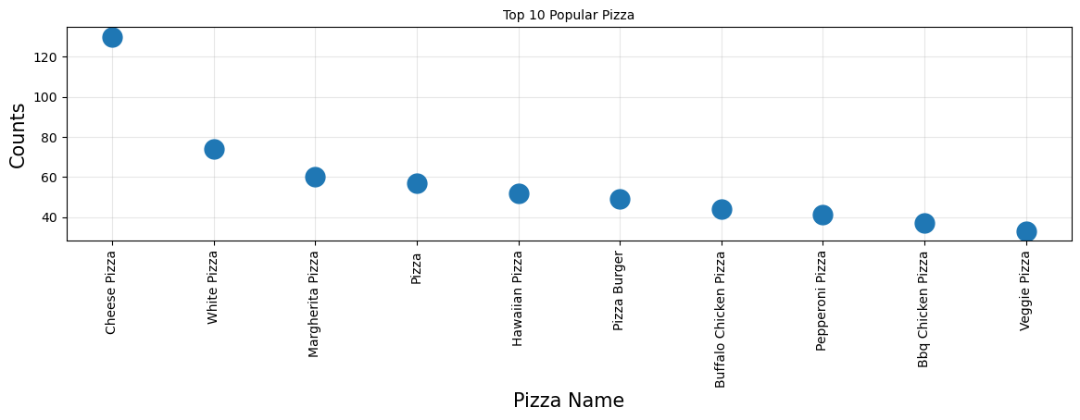
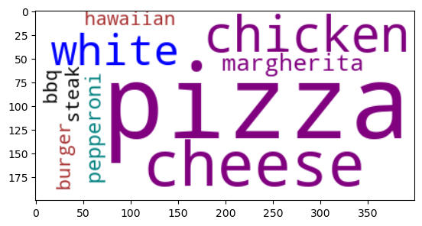
The Top 10 Popular Pizza in menus
Rank | Pizza Name | Frequency
1 | Cheese Pizza | 130
2 | White Pizza | 74
3 | Margherita Pizza | 60
4 | Pizza | 57
5 | Hawaiian Pizza | 52
6 | Pizza Burger | 49
7 | Buffalo Chicken Pizza | 44
8 | Pepperoni Pizza | 41
9 | BBQ Chicken Pizza | 37
10 | Veggie Pizza | 33

Slide 15
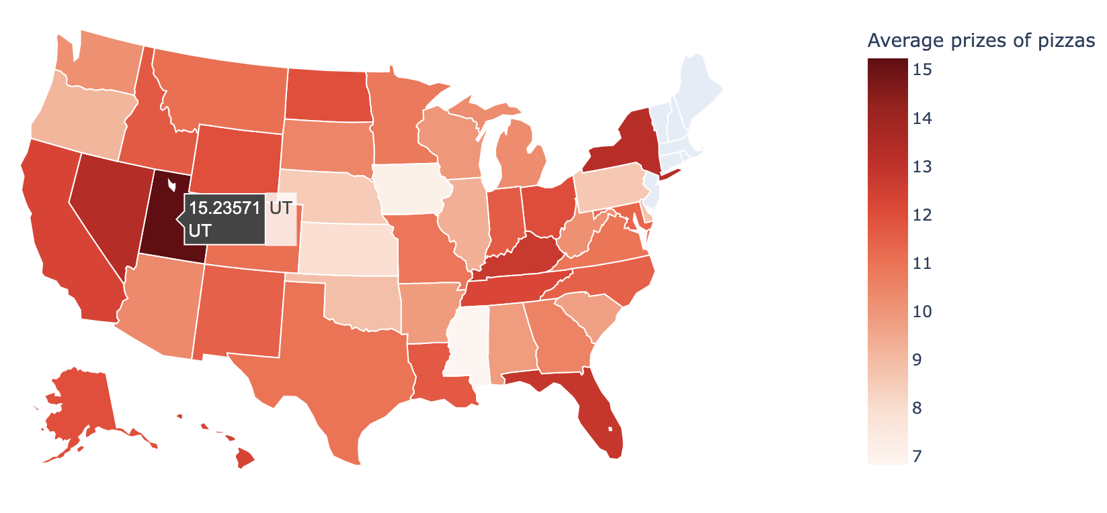
Average Prizes of Pizzas in the states
Rank​ | States | Prices
1​ | UT(Utah) | 15.24
2​ | NV(Nevada) | 13.35
3​ | NY(New York) | 13.28
4​ | FL​(Florida) | 12.83
5​ | KY(Kentucky) | 12.73

Slide 16
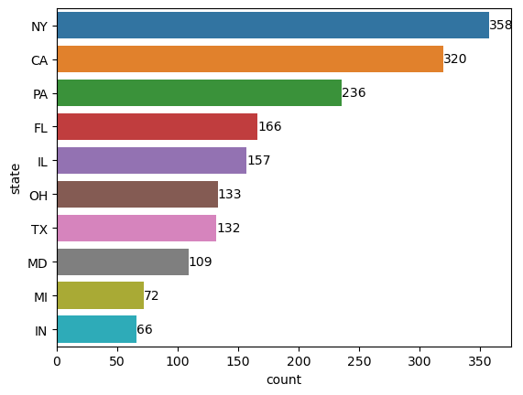
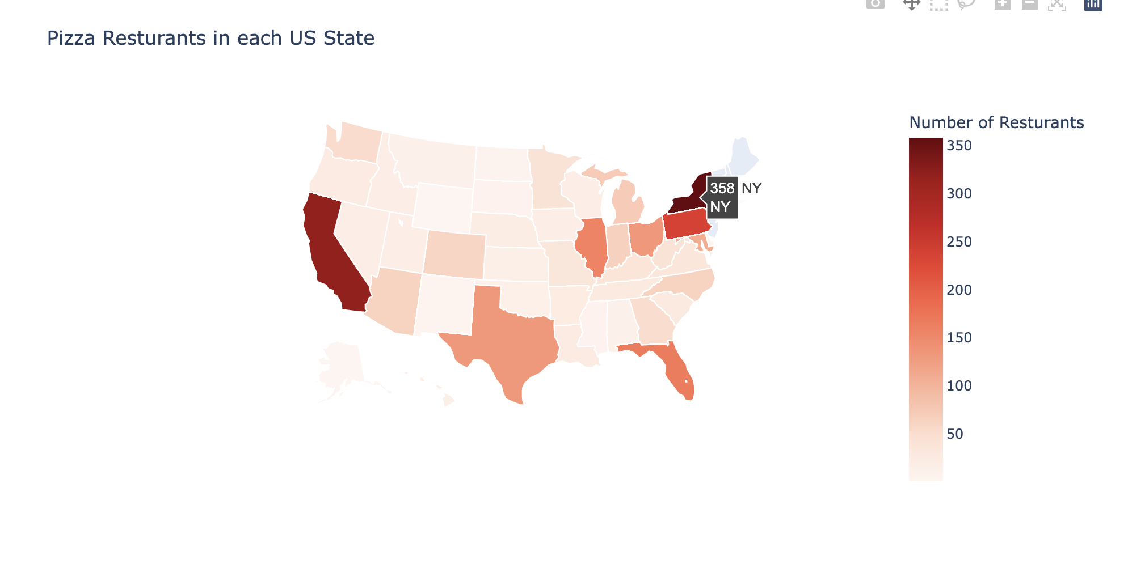

The Top 10 States in Amount of Pizza Restaurants in the US
320
CA
The top three states in amount of pizza:
NY: New York
CA: California
PA: Pennsylvania

Slide 17
03
Linear Regression Model
What factors are affecting the profit?

Slide 18
Linear Regression Model
Definition: Linear regression attempts to model the relationship between two variables by fitting a linear equation to observed data.
Utilize: In our analysis, we built linear regression models to find out which factors can bring more profits for investors.

Slide 19
Profit VS. GDP
There is a much tighter correlation between corporate profits and economic growth.
Approximate
Profit
GDP
Resource:
2016 US Real GDP by state: Accommodation and food services

Slide 20
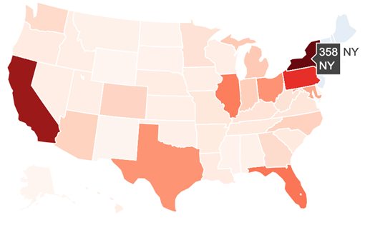
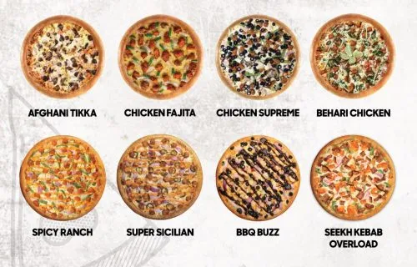


Variables Choosing
The popularity of res. location
The variety of pizza flavor
The price of pizza
The popularity of certain pizza flavors

Slide 21
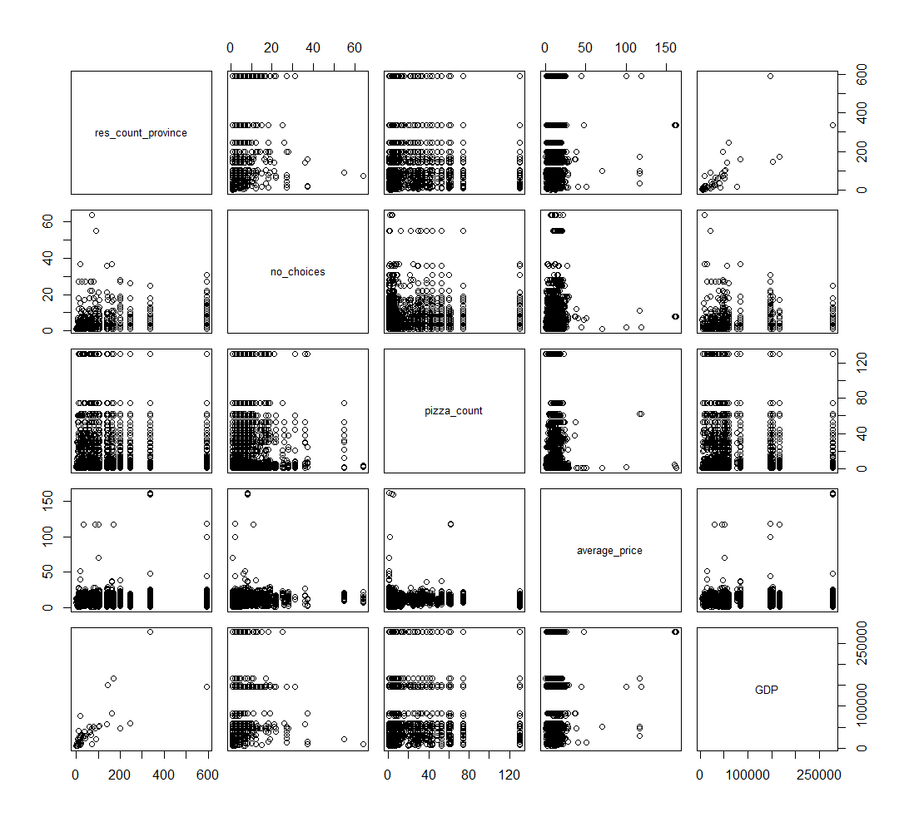
Virtualize relationships
A linear relationship can be observed between GDP and the popularity of res. location
Scatter plot

Slide 22
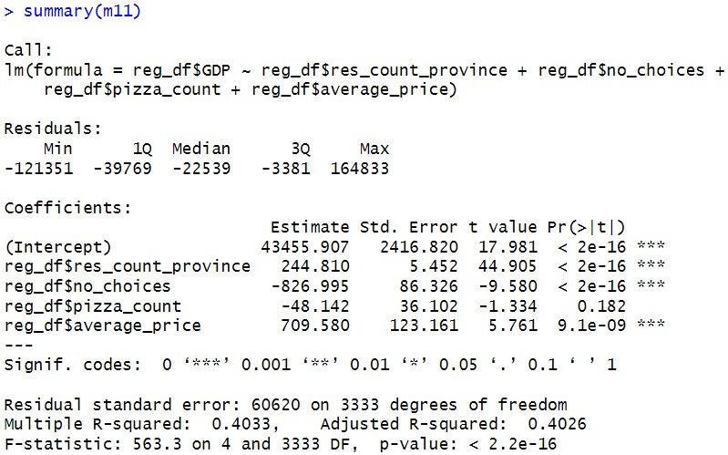
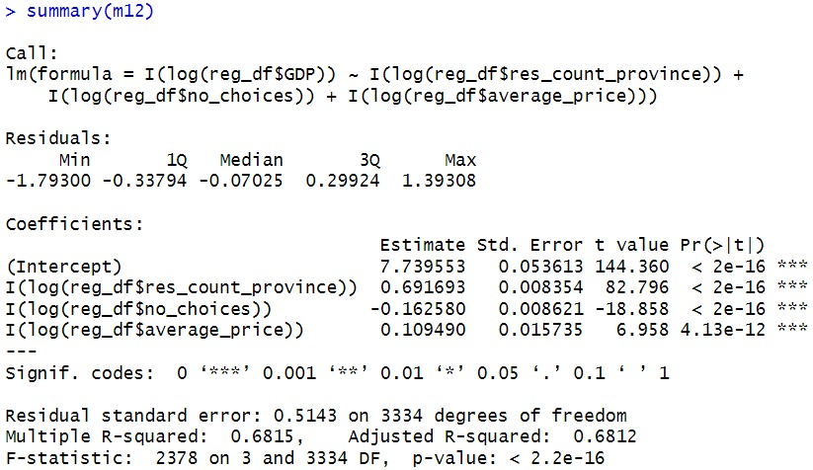
Fit Data into the Model
Apply log transformation and drop the popularity of a certain pizza flavors
Better Model!

Slide 23
Variables Choosing Modified
The popularity of res. location
The variety of pizza flavor
The popularity of certain pizza flavors
The price of pizza

Slide 24
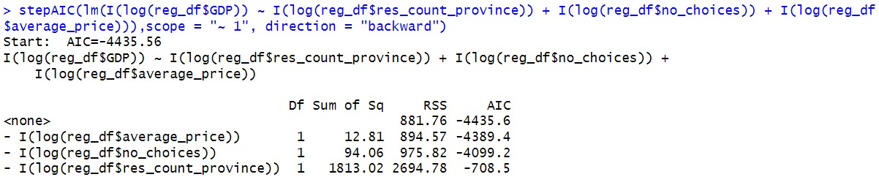
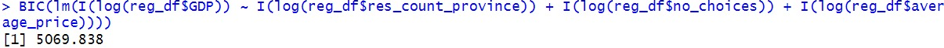
Examine the Model
The Akaike information criterion (AIC) and the Bayesian information criterion (BIC) provide measures of model performance that account for model complexity.
They combine a term reflecting how well the model fits the data with a term that penalizes the model in proportion to its number of parameters.
32,7%
10,9%

Slide 25
Examine the Model
By comparing to other models, our choices of predictors are significant, which has the smallest AIC and BIC.
The model is finalized!
32,7%
10,9%

Slide 26
Conclusion
Investors could consider the following to make more profits:
Operating res. In the provinces with enormous popularity
Limiting the provided flavor of pizza
Increases the pizza price

Slide 27
04
Confidence Interval & Prediction Interval
What range of the price we should set to maximize our profit?
Where should we operate the pizza restaurant?

Slide 28
Confidence Interval (CI)
Definition: The confidence interval (CI) is the range of values that you expect your estimate to fall between a certain percentage of the time if you run your experiment again or re-sample the population in the same way.
Utilize: In our analysis, we calculate the CI of the average price of pizza and the CI of the average price of the 5 most common pizzas, respectively.

Slide 29
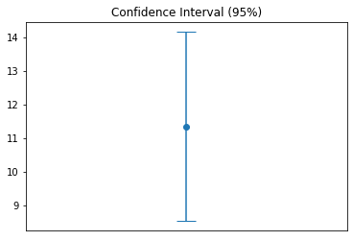
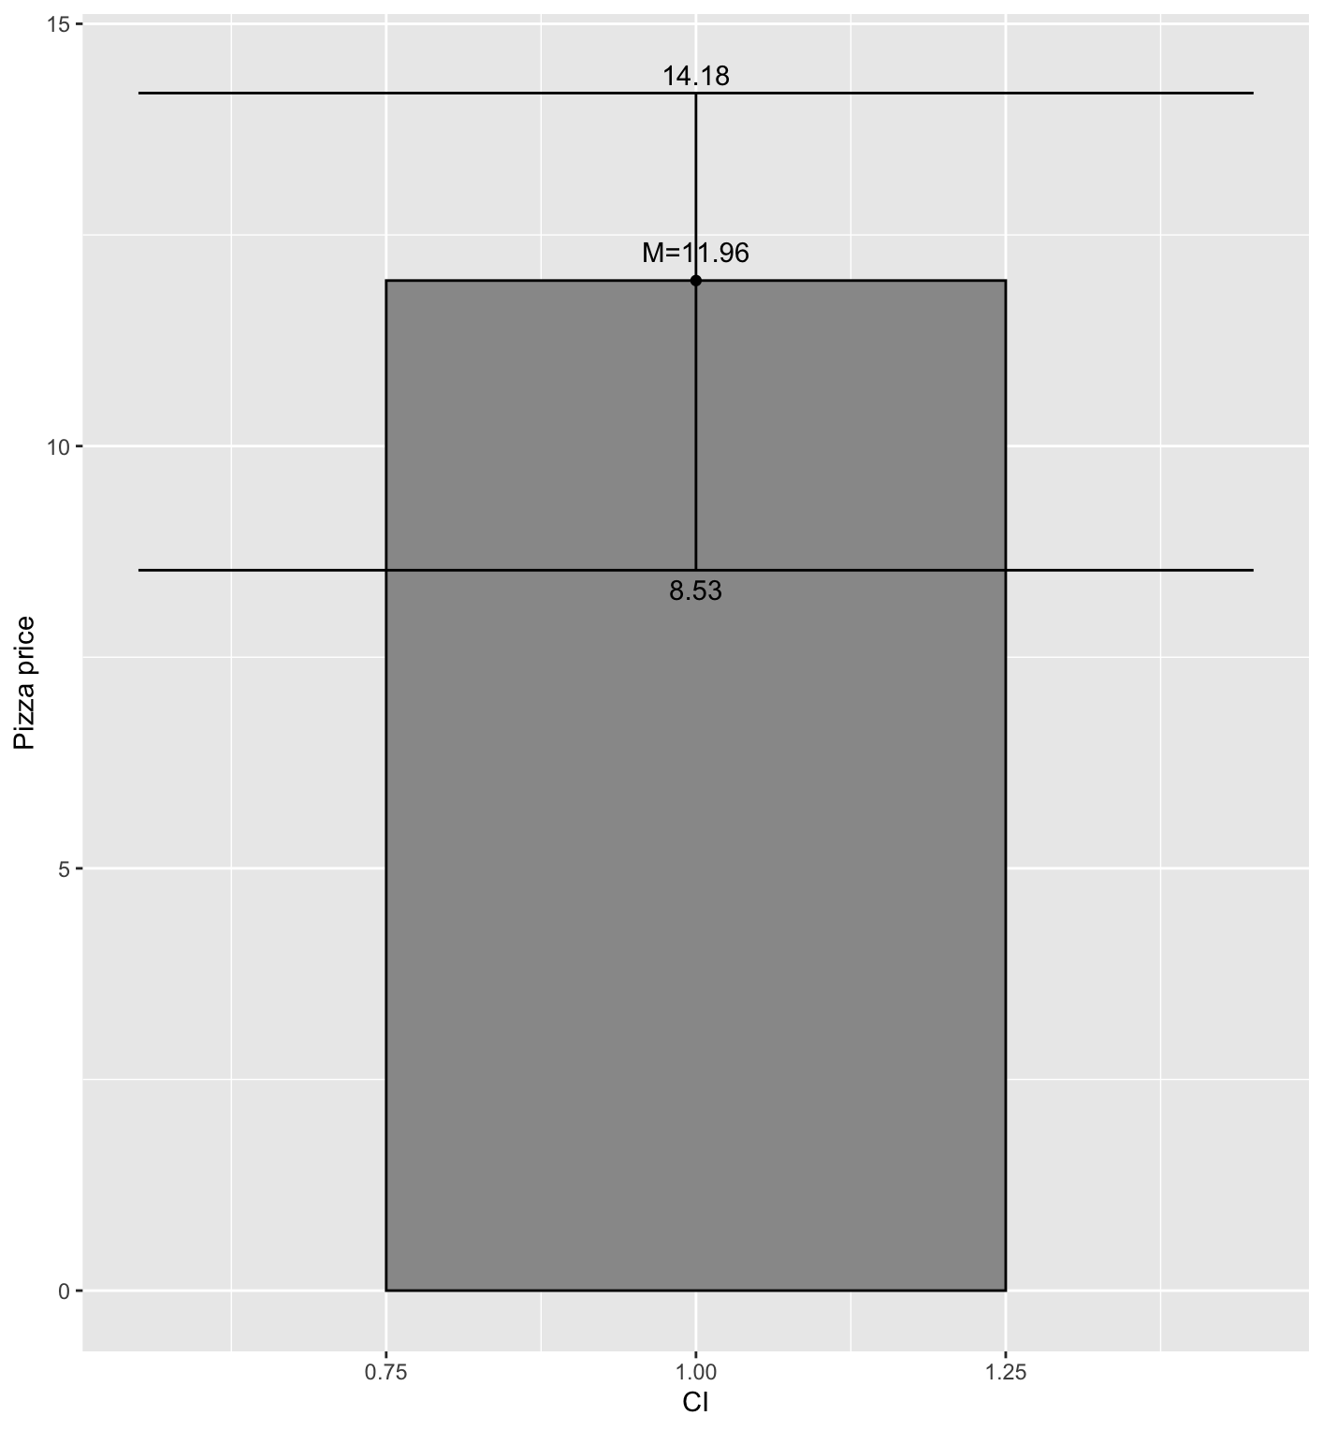

Visualize the confidence interval
For all pizzas, the CI of the average price is (8.53, 14.18).

Slide 30
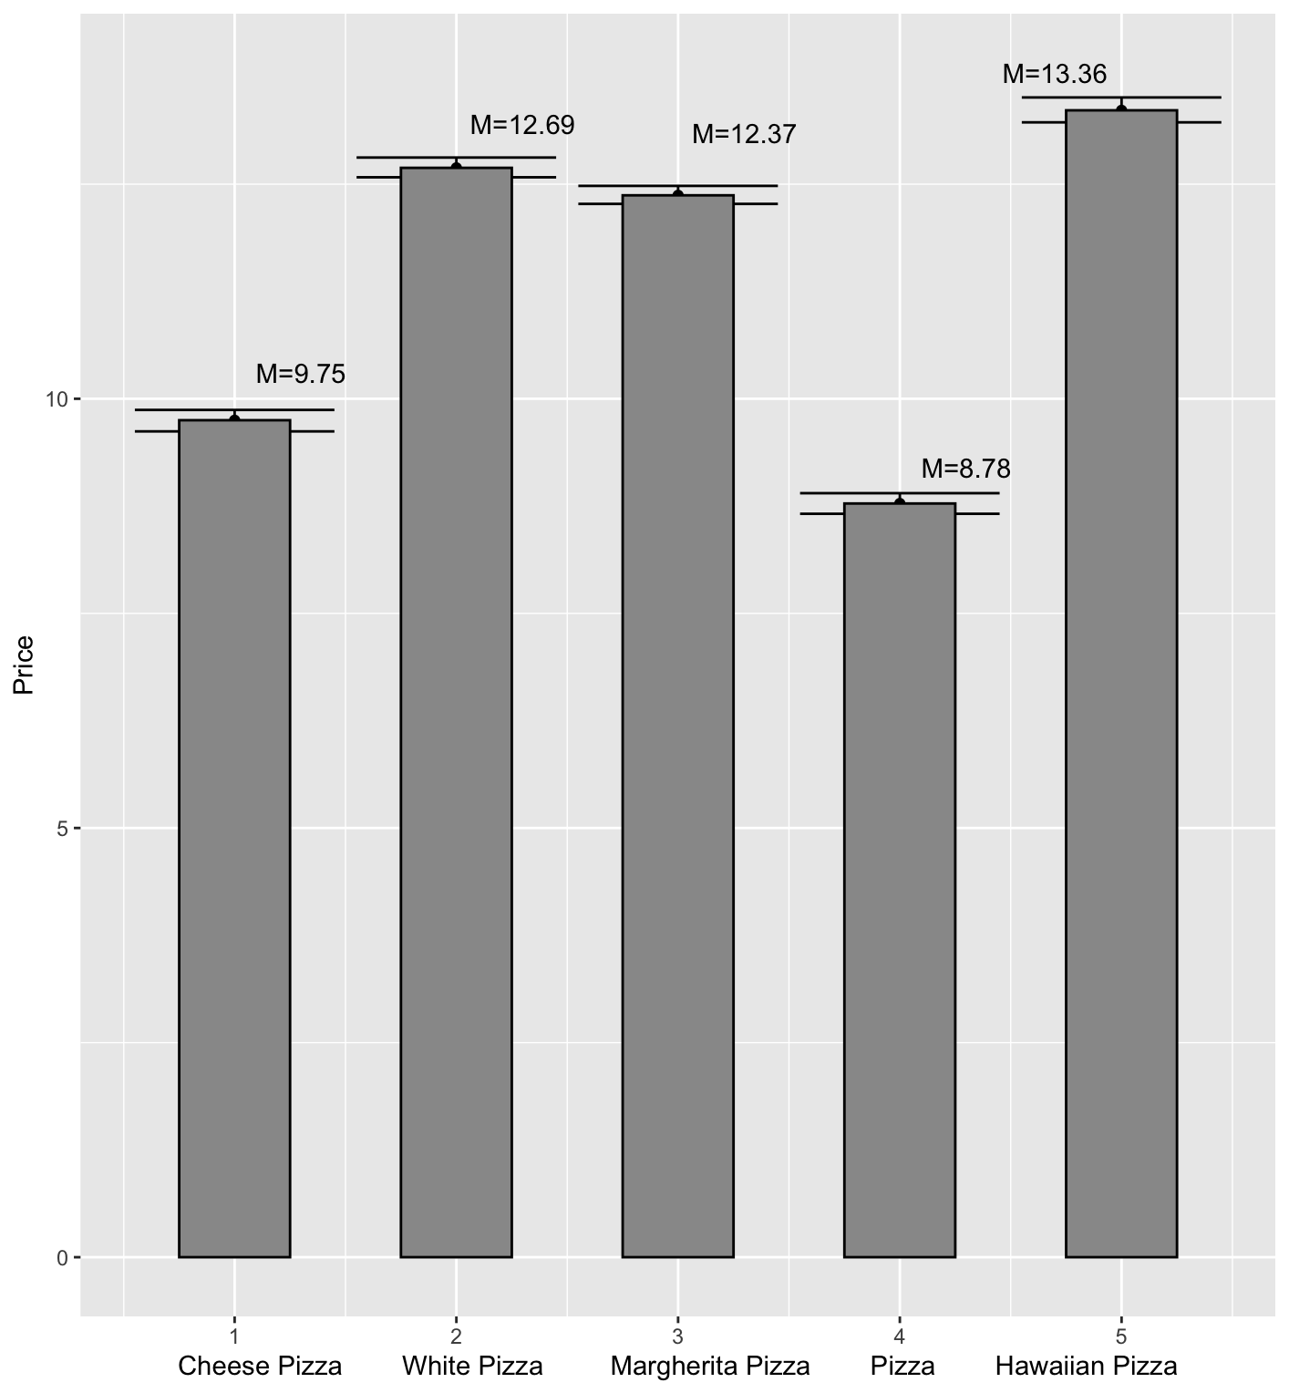
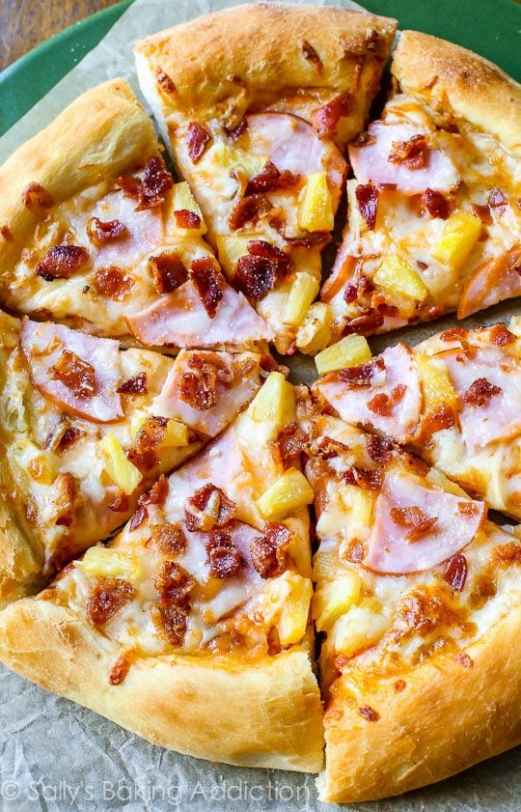
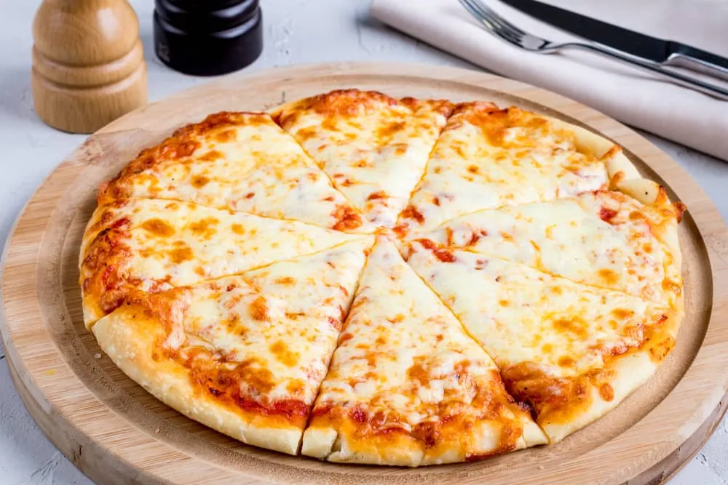
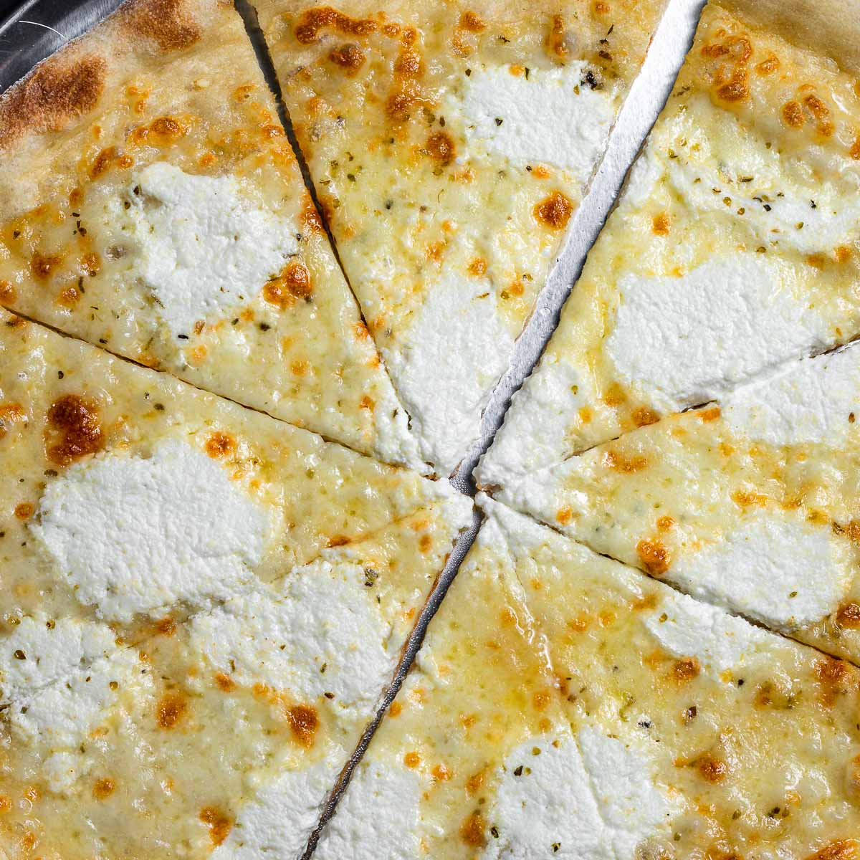
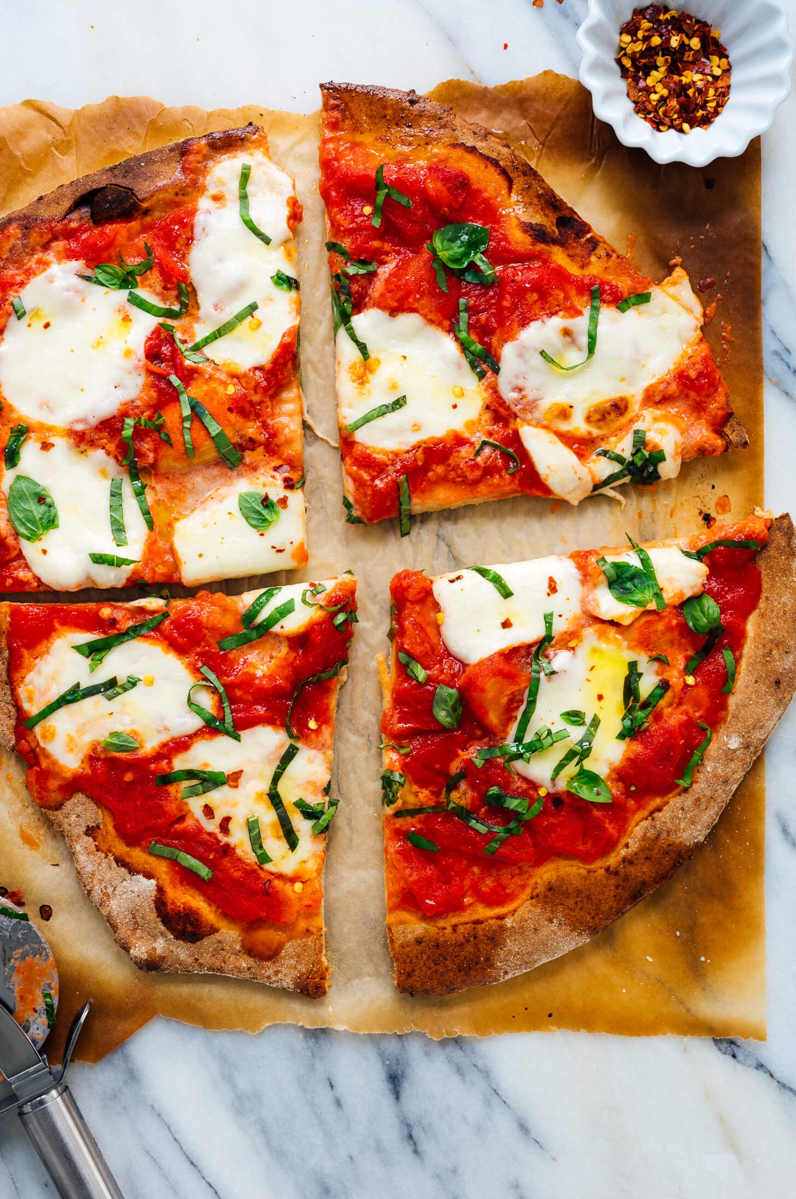
Visualize the confidence interval
Pizza Name | Price Range
Cheese Pizza | (9.62, 9.87)
White Pizza | (12.58, 12.81)
Margherita Pizza | (12.27, 12.48)
Pizza (Specific name not provided) | (8.66, 8.90)
Hawaiian Pizza | (13.22, 13.51)

Slide 31
Prediction Interval (PI)
Definition: A prediction interval (PI) is an estimate of an interval in which a future observation will fall, with a certain probability, given what have already been observed.
Utilize: In our analysis, we predict the prediction interval for GDP in a profit maximize situation.

Slide 32



Profit maximize situation
Increases the pizza price
CI upper limit for average price
Limiting the provided flavor of pizza
CI lower limit for the number of flavors choices
Operating res. In the provinces with enormous popularity
CI upper limit for the number of restaurants in provinces

Slide 33
Prediction Interval
Result:
The required 95% PI for GDP is
(33002.09, 248066.12)

Slide 34
05
Decision Tree
Predict the pizza price range by training model

Slide 35
Decision Tree Steps
Based on the mean of average price of pizza($11.96), create a new variable price.status.
If the average price of a pizza is higher than the mean, it is defined as Expensive, otherwise Normal.
39.7% pizza prices are expensive and 60.3% pizza prices are Normal.
According to the price.status variable, decision tree is applied to find out decision rule from other numeric variables exclude average price.

Slide 36




Decision Tree Steps
Training data | Test data
3000(85.47%) | 510(14.53%)
5. Random select 3000 samples from
the data set to train our decision tree
model.
6. Based on this training data, a decision tree
model is generated in R.
Data set
Training data
.
.
.
Random select

Slide 37
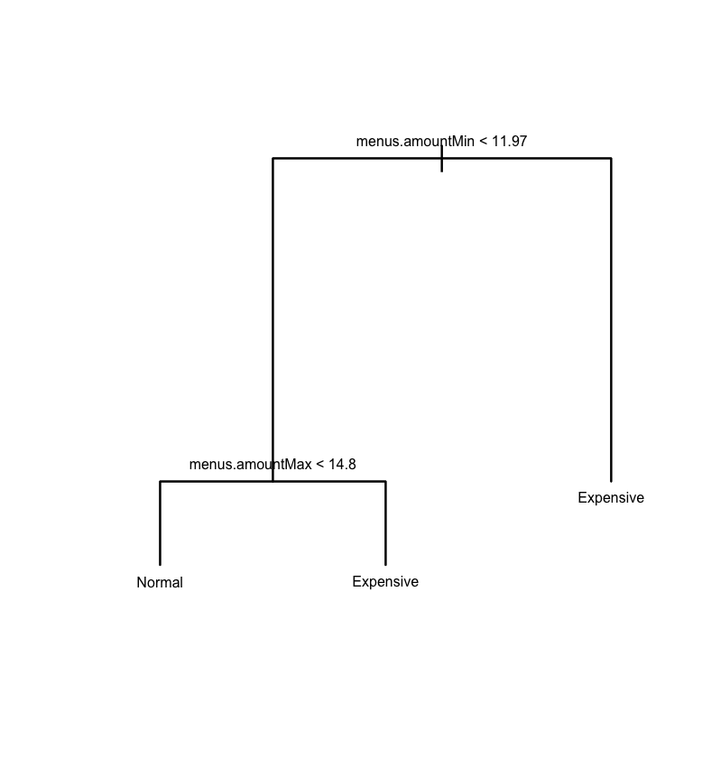
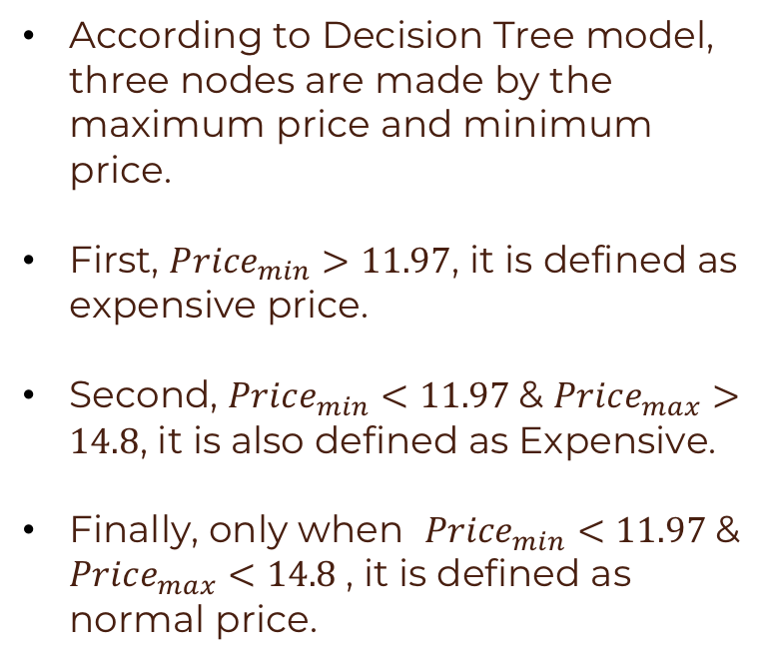
Decision Tree Result
According to Decision Tree model, three nodes are made by the maximum price and minimum price.
First, ${Price}_{min}>11.97$, it is defined as expensive price.
Second, ${Price}_{min}<11.97$& ${Price}_{max}>14.8$, it is also defined as Expensive.
Finally, only when ${Price}_{min}<11.97$& ${Price}_{max}<14.8$, it is defined as normal price.

Slide 38
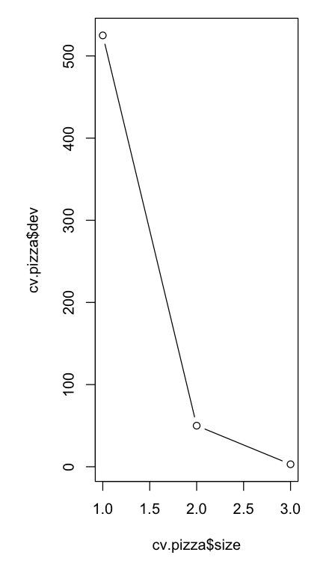
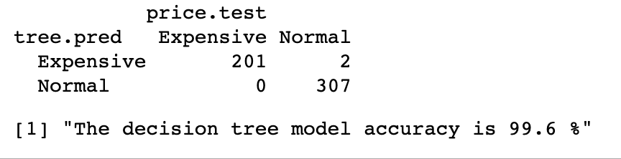
Decision Tree Test
Next, use this model to predict the price.status of the test data.
Then, Check the accurate rate between the prediction and real result.
Cross validation

Slide 39
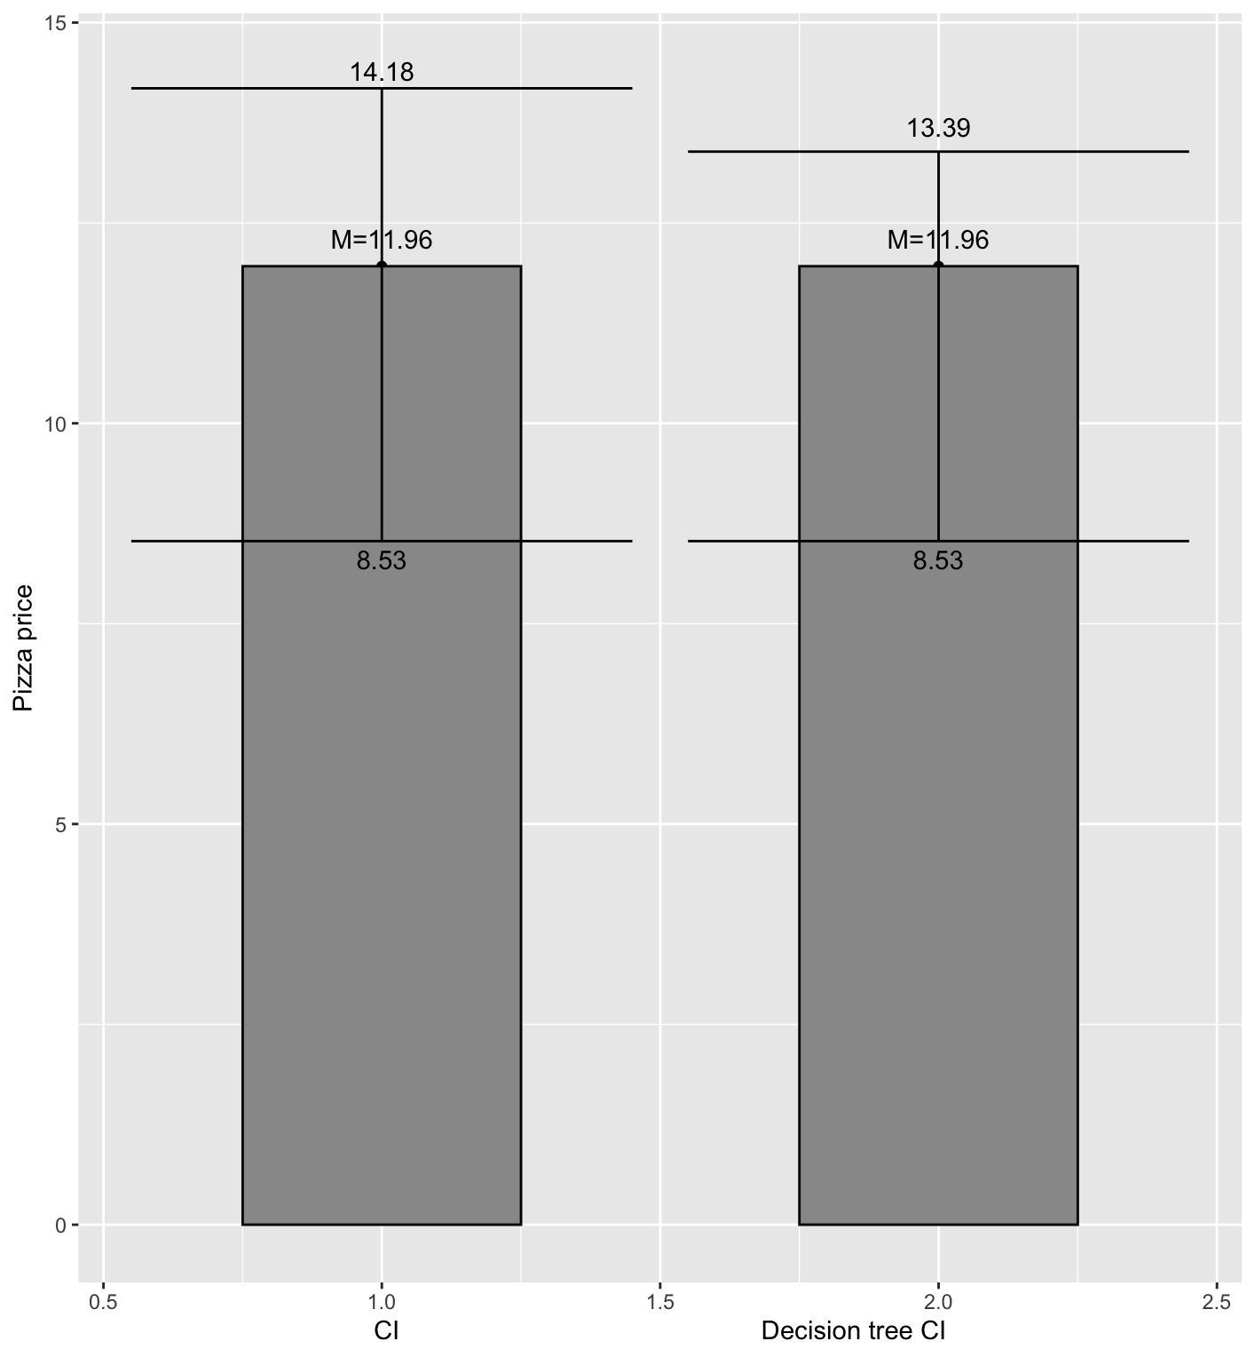
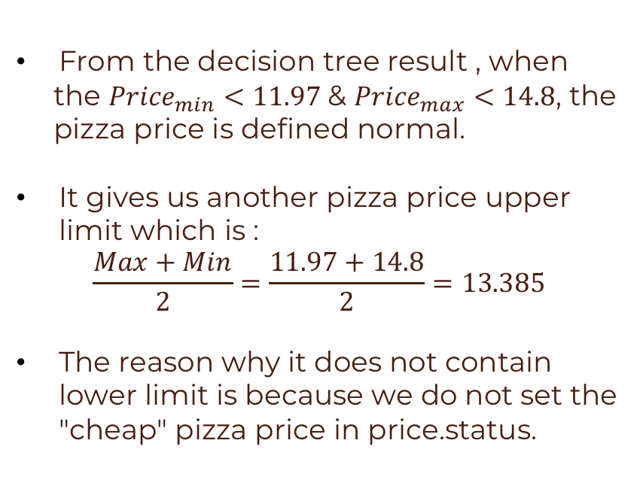
Decision Tree Application
From the decision tree result , when
the ${Price}_{min}<11.97$& ${Price}_{max}<14.8$, the
pizza price is defined normal.
It gives us another pizza price upper limit which is :
$$\frac{Max+Min}{2}=\frac{11.97+14.8}{2}=13.385$$
The reason why it does not contain lower limit is because we do not set the "cheap" pizza price in price.status.

Slide 40
06
Conclusion

Slide 41
Recommendations
 | Plan | Remarks
Pizza Brand | Do not join any chain restaurant, set up our own restaurant | Save money from the franchise fee
Pizza Type | The flavors of pizza should be limited | Cheese, White, Margherita, pizza and Hawaiian
Pizza Price | Use the decision tree | (8.53, 13.39)
Res. Location | Set it in the provinces with enormous popularity | New York, California, Pennsylvania

Slide 42
Pizza Restaurants Locations in the US
NY: New York
CA: California
PA: Pennsylvania

Slide 43
Model Evaluation
Linear Regression
Strength:
The regression analysis is straightforward and easy for us to see whether business factors we used are related to the GDP.
Weakness:
We applied log transformation, which could make the interpretation of coefficient become more complicated.
Data visualization
Strength:
We can see the result directly from the image and get a rough result immediately.
Weakness:
Lack of the key information such as pizza sales and pizza profit in the data set

Slide 44
Model Evaluation
CI and PI:
Strength:
A specific range can be obtained.
Weakness:
For prediction interval, the range is too large, so the reference value is not high.
Decision Tree
Strength:
Successfully find out the result of the decision rule
the accurate rate is 99.6%
Weakness:
The definition of Normal and expensive price is based on the average price, it could not reflect the actual expensive price definition of US citizens.
The data sets only included limited numeric variables, so the decision tree only took two variables (max and min) to decide it.

Slide 45
REFERENCE
DATA
https://raw.githubusercontent.com/rajeevratan84/data-analyst-bootcamp/master/8358_1.csv
2016 US Real GDP by state: Accommodation and food services
https://www.zipcode.com.ng/2022/06/list-of-5-digit-zip-codes-united-states.html
CODING
Data-Science-Analytics-AI-for-Business-the-Real-World-/Pizza Resturants Analysis.ipynb at main · PacktPublishing/Data-Science-Analytics-AI-for-Business-the-Real-World- (github.com)
POWERPOINT
Learning Fractions Google Slides theme and PowerPoint template (slidesgo.com)

Slide 46


THANKS!
https://github.com/Georgelsw/STAT3011-Project-2-GROUP-1-
Do you have any questions?

